Slide 1



DESIGN AND IMPLEMENTATION OF AN AUTONOMOUS SORTING SYSTEM USING MECHATRONICS PRINCIPLES AND AI
TEAM MEMBERS
1.PRADEEPA S
2.THIRUMENI V
3.BANUPRIYA V
UNDER GUIDANCE OF:
DR. R. LAL RAJA SINGH
(PROFESSOR/EEE)
KIT-KalaignarKarunanidhi Institute Of Technology

Slide 2


ABSTRACT
This project presents an autonomous sorting system that uses mechatronics and AI to identify and sort objects based on size, shape, and colour. Materials are initially dumped onto a primary conveyor where AI-driven cameras classify them. A robotic arm places the sorted items onto a secondary conveyor for sensor validation, followed by final sorting into bins using robotic or pneumatic actuators. The system adapts to dynamic environments and ensures accurate, efficient, and intelligent sorting.

Slide 3
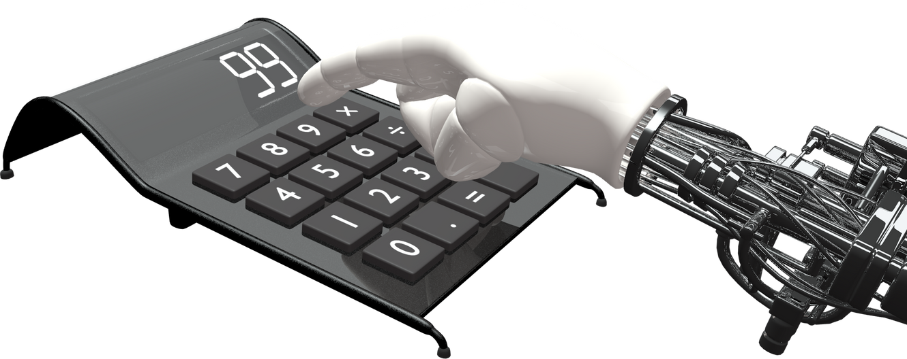
PROBLEM STATEMENT
To develop an autonomous sorting system capable of identifying and categorizing heterogeneous objects based on physical attributes like shape, size, and color. The system should use AI for object classification, mechatronic components for actuation and sensing, and operate in dynamic environments with real-time feedback.

Slide 4
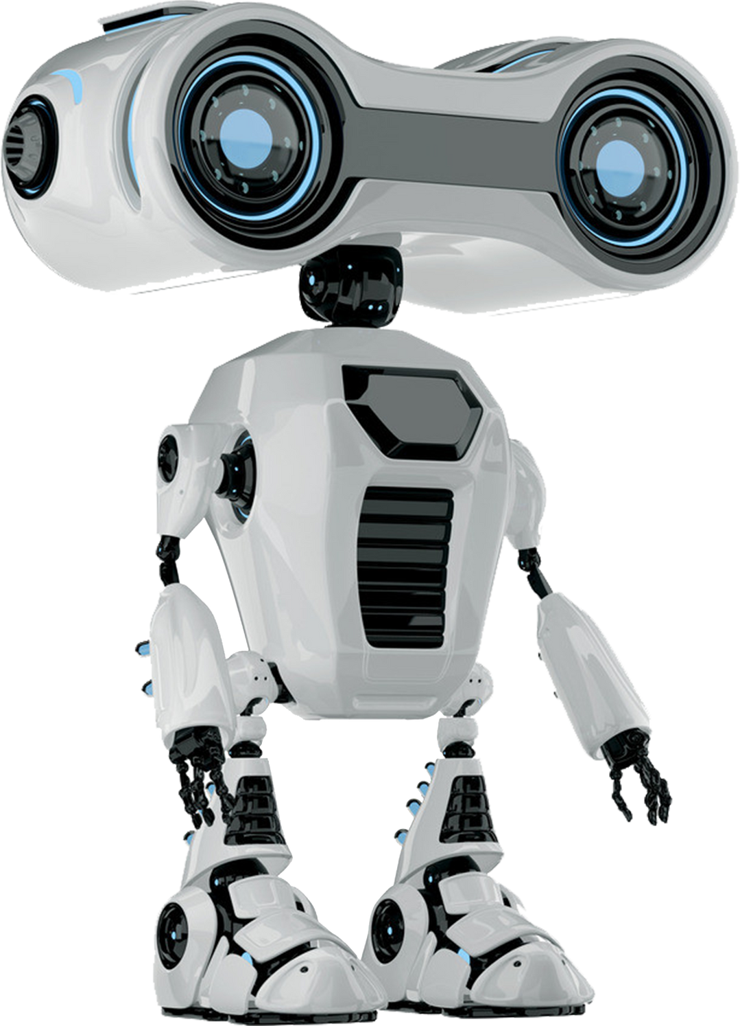
EXISTING SYSTEMS
Manual Sorting Systems – Labor-intensive, low efficiency, prone to human error.
Conveyor with Proximity Sensors – Basic automation with limited adaptability, no AI integration.

Slide 5
PROPOSED SOLUTION
A primary conveyor where mixed objects are dumped.
AI-driven cameras (e.g., OpenCV with Raspberry Pi or Jetson Nano) for object detection and classification.
A robotic arm to sort detected objects onto a secondary conveyor.
On the secondary conveyor, IR, ultrasonic, and color sensors ensure accurate validation.
Based on sensor output, secondary robotic arms or pneumatic actuators place objects into appropriate bins.
An embedded controller (Arduino/Raspberry Pi) coordinates all tasks, while AI/ML models enhance classification over time.

Slide 6
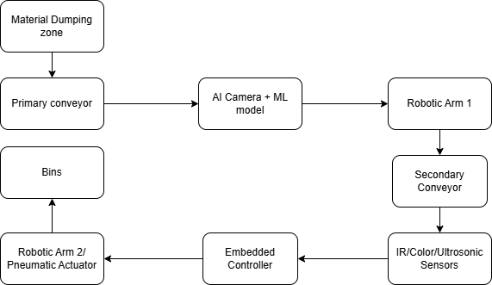
BLOCK DIAGRAM

Slide 7
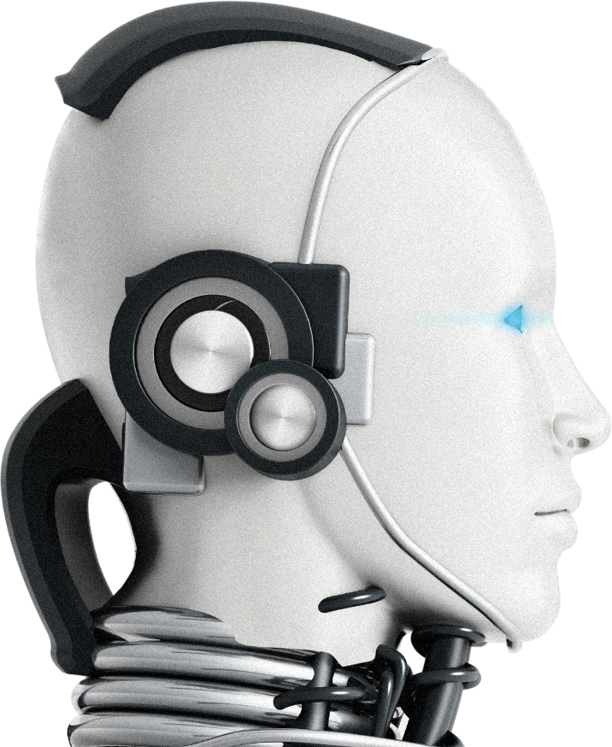
TECHNICAL APPROACH
Hardware:
Camera: Raspberry Pi Camera or USB HD Cam
Controller: Raspberry Pi (AI processing) + Arduino Uno (actuator control)
Sensors: IR sensor, Ultrasonic sensor, Color sensor (e.g., TCS3200)
Actuators: Servo motors / Robotic arms / Pneumatic cylinders
Conveyors: Two stages (Primary & Secondary)

Slide 8
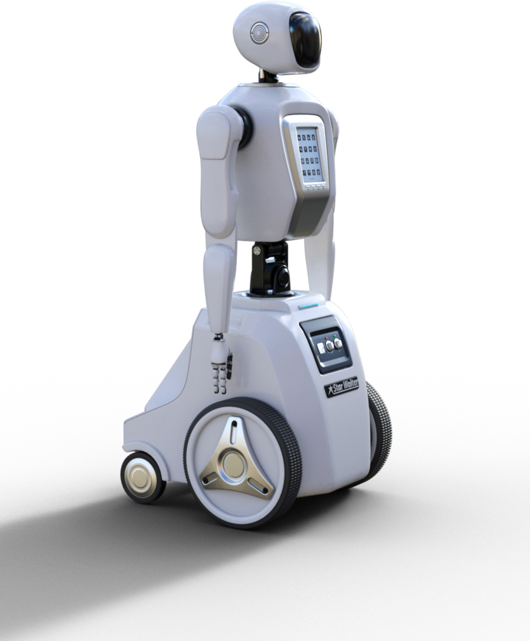
SOFTWARE IMPLEMENTATION
Object Detection: OpenCV, TensorFlow Lite
Classification: Pre-trained ML models (CNN for shape/color recognition)
Real-time Control: Python (on Pi), Arduino C/C++
Feedback Loop: Sensor data to adjust conveyor speed and arm response

Slide 9

CONCLUSION
Successfully integrates AI and mechatronics for automated sorting.
Accurately classifies objects based on shape, size, and color.
Dual-stage system enhances precision and scalability.
Real-time feedback enables dynamic adaptability.
Applicable in industrial, recycling, and automation environments.

Slide 10
THANK YOU

